Slide 1
Advanced Analysis in Machine Learning: Classification and Time Series
Machine Learning & Neural Network
Done By: Anas Moosa, Khaled Shrouf, Salem Nsour

Slide 2
Introduction
Our project aims to build different Machine Learning Models to get future predictions or classify some features to given labels.
We used two datasets one for classification purpose which is
(Mobile Pricing dataset) And the other is for Time-series Models (Vehicle dataset).
For the classification models we built the following Models:
1-MLP , 2- SVM , 3- Random Forest , 4- Gradient Boosting
For the Time Series we built the following Models:
1- ESN , 2- LSTM , 3- BI-LSTM

Slide 3
Classification Models
Dataset description:
Mobile Pricing Dataset
This data set contains 2000 entries of 21 different features that are main factors in mobile pricing method in both technical and consumer-oriented features, such as: ram, camera pixels, battery power, memory and more..
The target classes is the price range where it will be classified into 4 classes (0, 1, 2, 3) depending on the features.

Slide 4
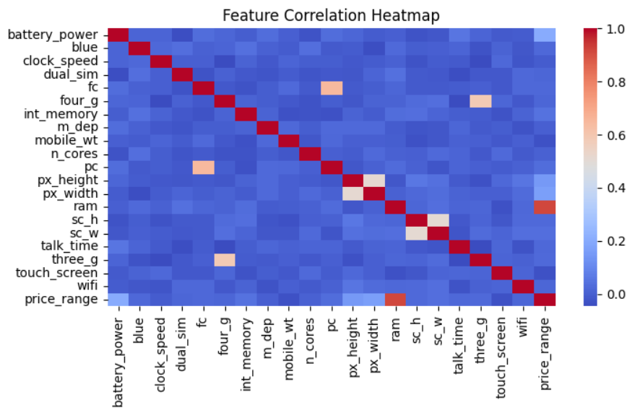
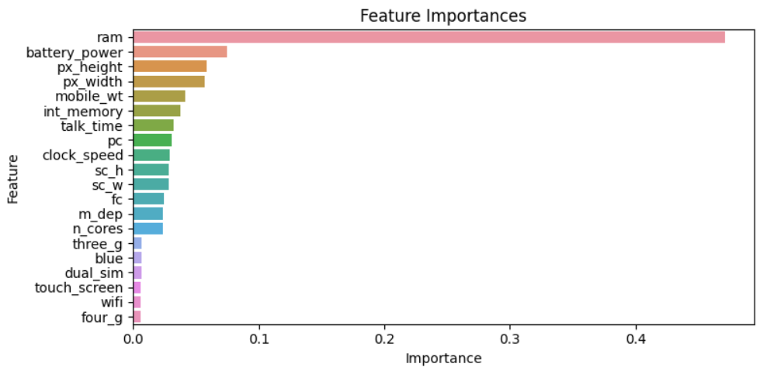
Dataset Insights
We used two different plots to get some insights of the data.
Feature Importance Plot: This visual represents the significance of different features in predicting the target variable.
Correlation Heatmap: It's a graphical representation of the correlation matrix, showing how different variables are related to each other.

Slide 5
Dataset Preprocessing
Dimensionality reduction: as shown in the previous slide, we found that 6 out of the 20 features are unimportant so we decided to drop those 6 features (3g, blue, dual_sim, touch_sceen, wifi, 4g).
Data Splitting: we split the dataset into 80% for training, and 20% for testing.

Slide 6
Models Description
Multi Layer Perceptron:
A model which consists of at least three layers of nodes: an input layer, one or more hidden layers, and an output layer. Each node, or neuron, uses a nonlinear activation function, except for input nodes. MLP utilizes a supervised learning technique called backpropagation for training
Support Vector Machine:
finding the hyperplane that best divides a dataset into classes. The strength of SVM lies in its use of kernels, which allow the algorithm to operate in a high-dimensional space, and its effectiveness in high-dimensional spaces.

Slide 7
Models Description
Random Forest:
ensemble learning method, particularly effective for classification tasks. It operates by constructing a multitude of decision trees at training time and outputting the class that is the mode of the classes output by individual trees.
Gradient Boosting:
a machine learning technique used for both classification and regression problems. It builds the model in a stage-wise fashion like other boosting methods, but it generalizes them by allowing optimization of an arbitrary differentiable loss function. In gradient boosting, trees are built sequentially, with each tree being trained to correct the mistakes of the previous ones.

Slide 8
Experiment Setup and Results:
MLP Model:
Hyperparameter Tuning:
Implemented using GridSearchCV from Scikit-learn.
The model was trained with a maximum of 1500 iterations over a 5-fold cross-validation setup.
The best parameters :
Best MLP Hyperparameters: {'activation': 'relu', 'alpha': 0.0001, 'batch_size': 64, 'early_stopping': False, 'hidden_layer_sizes': (100, 50, 25), 'learning_rate_init': 0.01, 'solver': 'adam', 'validation_fraction': 0.1}
Results:
The MLP model achieved an accuracy of 74.5%

Slide 9
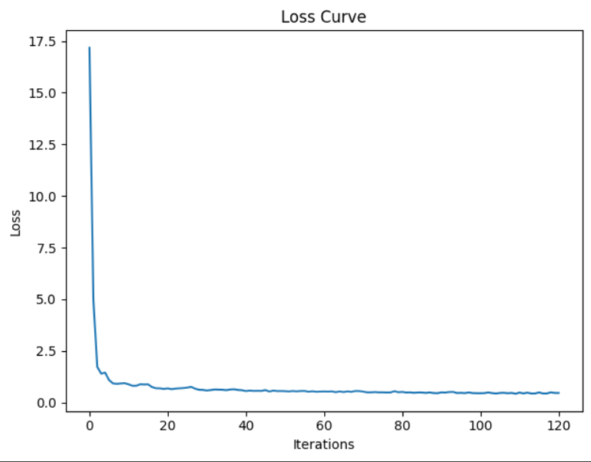
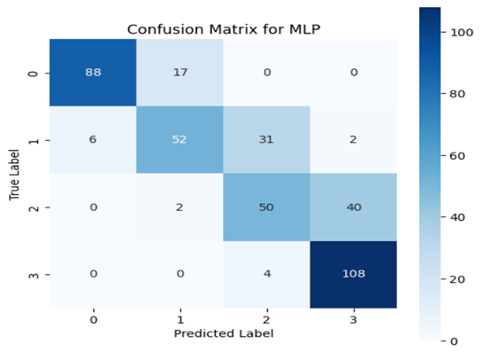
Experiment Setup and Results:
Loss Curve (MLP Model):
A plot of the loss curve over iterations was generated, showing the model's convergence behavior during training.
confusion matrix:
visually represented the model's performance, highlighting the correct and incorrect predictions across different classes.

Slide 10
Experiment Setup and Results:
SVM Model:
Hyperparameter Tuning:
Conducted using Optuna, a hyperparameter optimization framework.
The model aimed to maximize accuracy, with the tuning process running for 50 trials.
The best parameters :
{'C': 7.86231872191541, 'gamma': 'auto', 'kernel': 'linear'}
Results:
The optimized SVM model achieved an accuracy of 98%.

Slide 11
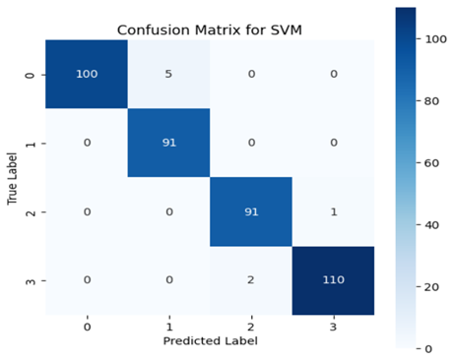
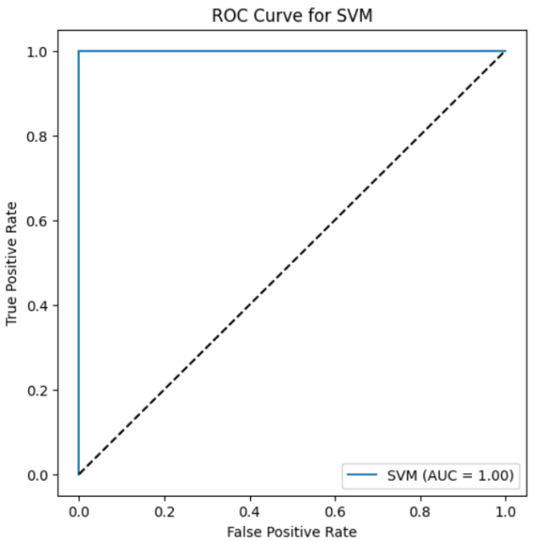
Experiment Setup and Results:
ROC Curve and AUC:
Generated a Receiver Operating Characteristic (ROC) curve, showcasing the trade-off between sensitivity and specificity.
The Area Under the Curve (AUC) was 1,00, indicating the model's effectiveness in distinguishing between classes.
confusion matrix:
visually represented the model's performance, highlighting the correct and incorrect predictions across different classes.

Slide 12
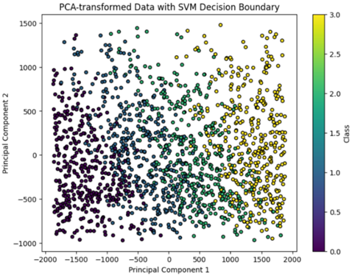
Experiment Setup and Results:
PCA Analysis:
Applied Principal Component Analysis (PCA) to reduce the dataset to two principal components for visualization.
The PCA-transformed data was visualized, showing the separation of classes and the decision boundary of the SVM model.

Slide 13
Experiment Setup and Results:
Random Forest Model:
Hyperparameter Tuning:
Conducted using GridSearchCV from Scikit-learn
The tuning process used a 5-fold cross-validation setup.
Results:
The optimized RF model achieved an accuracy of 91.5%.

Slide 14
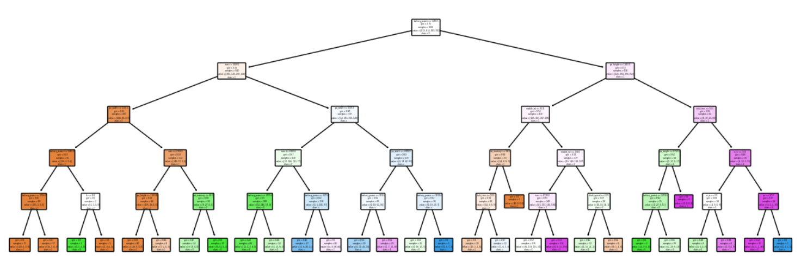
Experiment Setup and Results:
Tree Visualization:
A single tree from the Random Forest was visualized, offering insights into the decision-making process of the model.

Slide 15
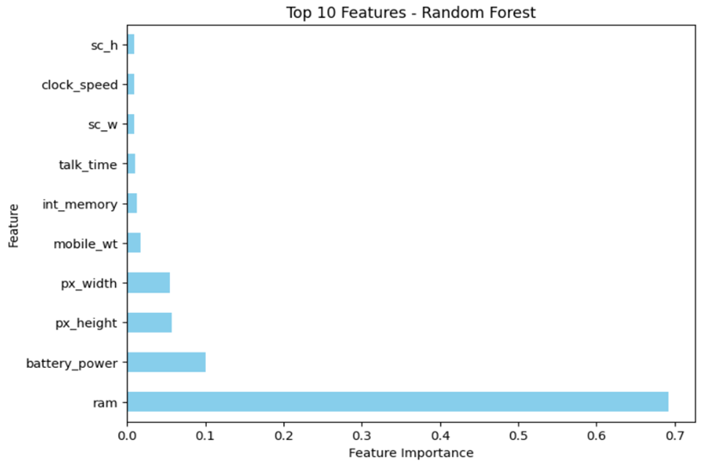
Experiment Setup and Results:
Feature Importance:
The top 10 most important features were identified and visualized in a bar chart, highlighting their relative importance in the model.

Slide 16
Experiment Setup and Results:
Gradient Boosting Model:
Hyperparameter Tuning:
Conducted using RandomizedSearchCV from Scikit-learn
The tuning process used a 5-fold cross-validation setup and was iterated for 100 trials.
Results:
The optimized GB model achieved an accuracy of 89%.

Slide 17
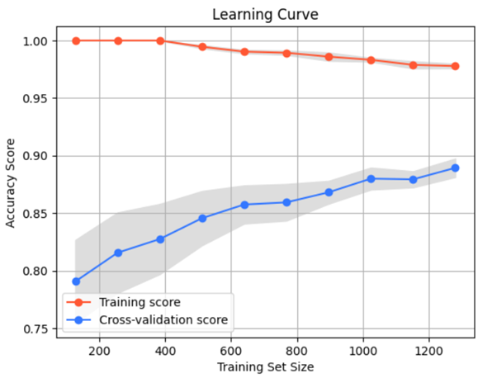
Experiment Setup and Results:
Learning Curve:
A learning curve was plotted to evaluate the model's performance over different training set sizes, indicating how well the model learns as more data is provided

Slide 18
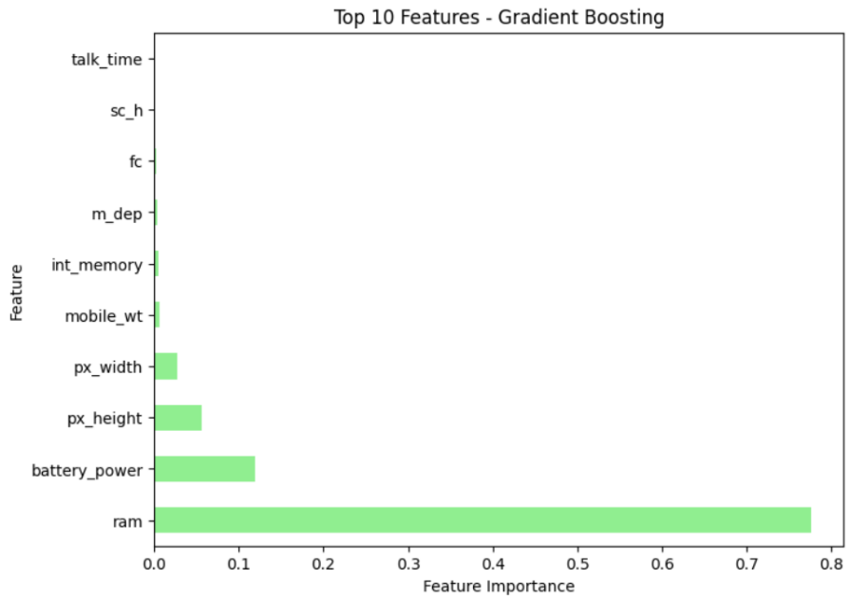
Experiment Setup and Results:
Feature Importance:
The top 10 most important features were identified and visualized in a bar chart, highlighting their relative importance in the model.

Slide 19
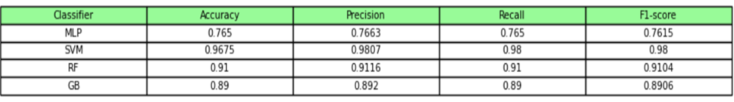
Comparative Analysis of Classifier Performances:
A comprehensive performance comparison of the four classifiers - MLP, SVM, RF (Random Forest), and GB (Gradient Boosting) - is presented below. The table summarizes key performance metrics for each model, including accuracy, precision, recall, and F1-score.

Slide 20
Time-Series Models
Dataset description:
This dataset provides a detailed account of vehicle traffic, quantified on an hourly basis. It is structured into two primary columns:
Hour: This column signifies the hour of the day, ranging from 1 to 1689, corresponding to a 24-hour time format along estimated 70 days. Each entry in this column is an integer representing a specific hour during which vehicle data was recorded.
Vehicles: The 'Vehicles' column enumerates the number of vehicles observed or counted at the corresponding hour. These values are integral, denoting the total vehicle count per hour.

Slide 21
Dataset Preprocessing
Normalization Technique: The data is normalized using the Min-Max Scaler, This method scales the 'Vehicles' column, transforming the data so that it falls within a given range,0 to 1.
Data Splitting: we split the dataset into 80% for training, and 20% for testing.

Slide 22
Models Description
Echo State Network (ESN):
type of recurrent neural network known for its efficient training. It features a fixed, randomly generated reservoir of neurons where only the output weights are trained. This makes it ideal for complex time series predictions.
Long Short-Term Memory networks (LSTM):
type of recurrent neural network (RNN) optimized to remember information for long durations. They are effective for time series analysis and natural language processing.
Bidirectional Long Short-Term Memory
(BI-LSTM):
are an extension of LSTM networks. They process data in both forward and backward directions, allowing them to capture context from both past and future states. This bidirectional approach enhances the model's ability to understand context in sequence data, making it highly effective for complex tasks in time series prediction and text analysis.

Slide 23
Experiment Setup and Results:
Echo State Network:
Input weights are randomly initialized and connect the input to the reservoir.
Reservoir weights are also initialized randomly but are then sparsely connected and scaled to achieve the desired spectral radius, a critical factor in the stability and dynamics of the reservoir.
A Ridge Regression is then used to train the readout layer. This linear model is preferred for its stability and ability to handle collinearity.
Results:
The final output includes the MSE values for both training and test sets, showing the model's performance.
(0.03486517463912167, 0.03513322970557431)
An array of predictions on the new input data, representing the model's forecast in the original scale of the data.
array([ 193.55924964, 189.63611615, 440.64406888, 1529.16525209,
4843.0005764 ])

Slide 24
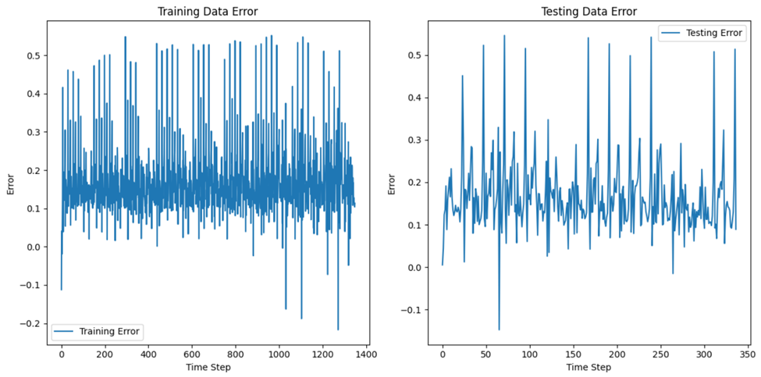
Experiment Setup and Results:
Training and Testing Data Error Plot:
This plot visualizes the errors (residuals) for both training and testing data.

Slide 25
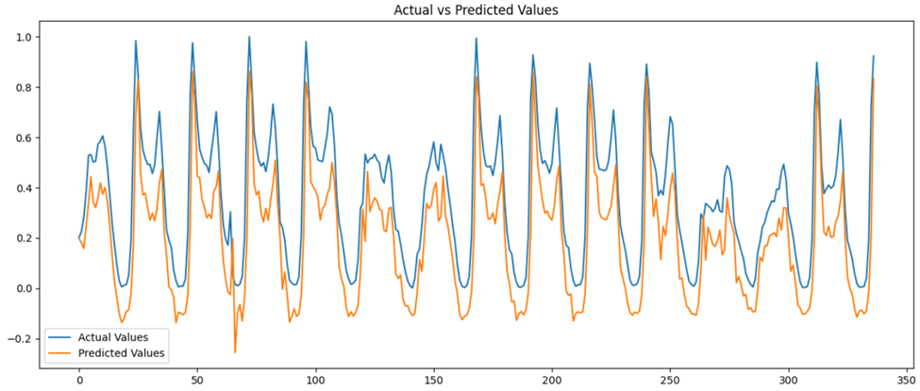
Experiment Setup and Results:
Actual vs. Predicted Values Plot:
This plot compares the actual values of the test dataset with the values predicted by the model.

Slide 26
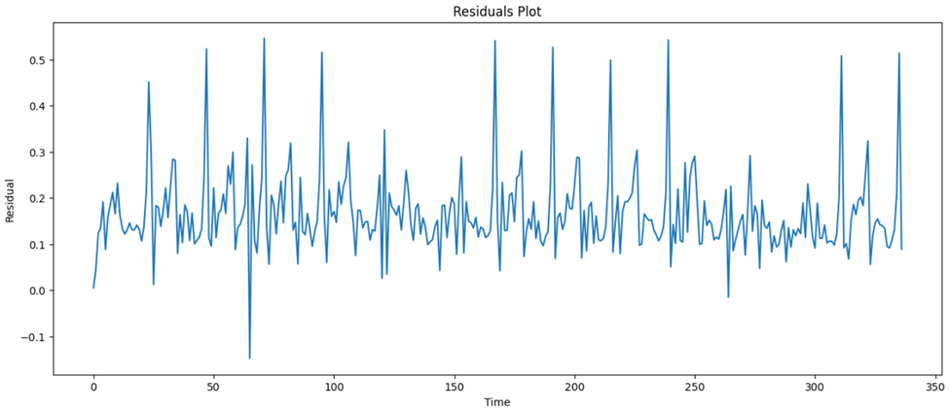
Experiment Setup and Results:
Residuals Plot:
The residuals plot shows the difference between the actual values and the predicted values (residuals) over time for the test data.

Slide 27
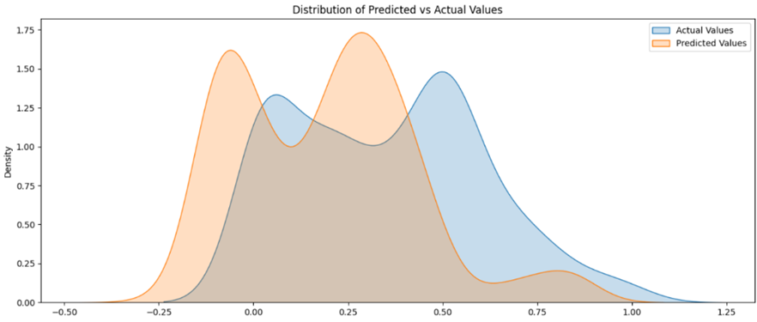
Experiment Setup and Results:
Distribution of Predicted vs. Actual Values:
This plot uses kernel density estimation (KDE) to visualize the distribution of both the actual and predicted values.

Slide 28
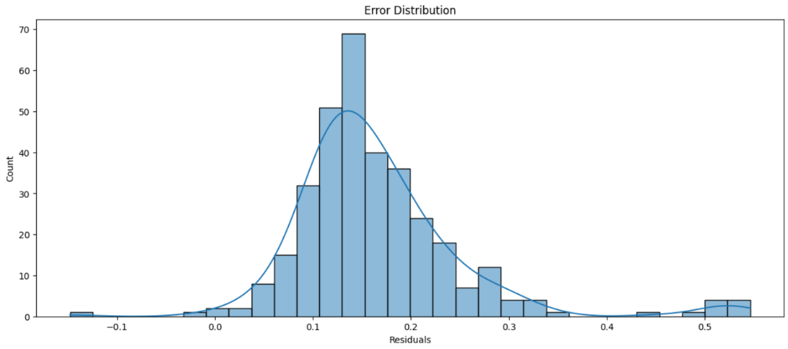
Experiment Setup and Results:
Error Distribution Plot:
This histogram, enhanced with a kernel density estimate (KDE), shows the distribution of the residuals (errors).

Slide 29
Experiment Setup and Results:
Long Short Term Memory Model:
The LSTM model is built using a sequential model architecture, a standard approach in Keras for creating models in a step-by-step fashion.
The model is compiled with the Adam optimizer, The loss function used is 'mean_squared_error’
The model is trained on the training dataset (X_train, y_train) for 20 epochs, with a batch size of 150.

Slide 30
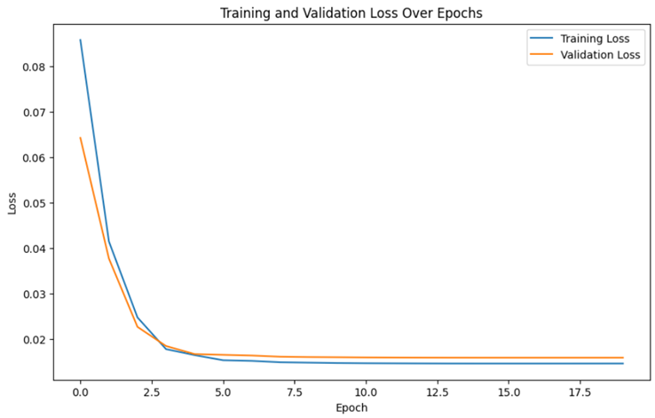
Experiment Setup and Results:
Training and Testing over epochs Plot:
This plot shows the loss (mean squared error) for both training and validation (testing) datasets over the course of 20 training epochs.

Slide 31
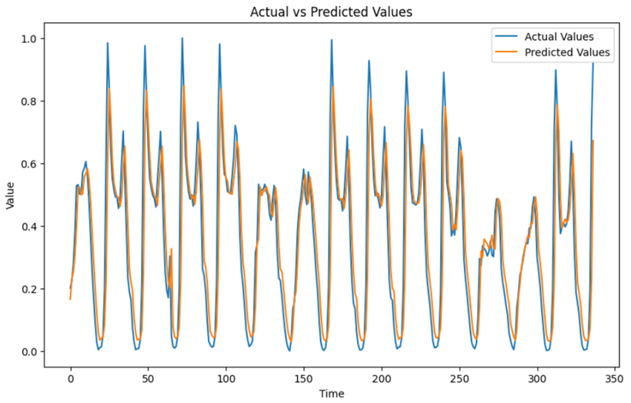
Experiment Setup and Results:
Actual vs. Predicted Values Plot:

Slide 32
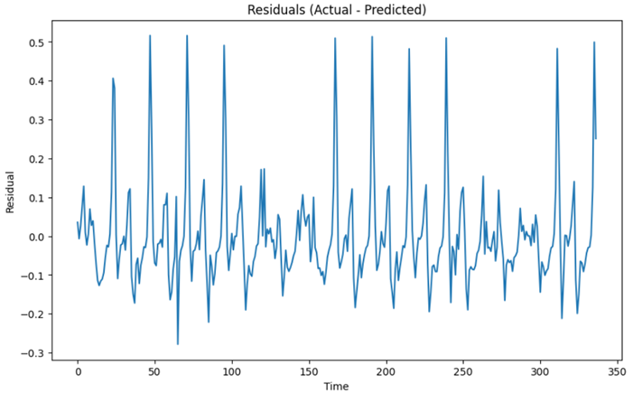
Experiment Setup and Results:
Residuals Plot:

Slide 33
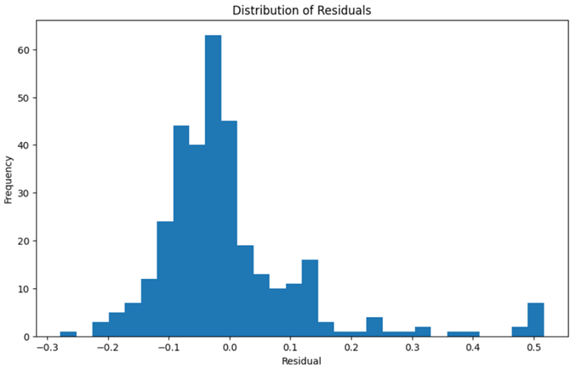
Experiment Setup and Results:
Distribution of Residuals:

Slide 34
Experiment Setup and Results:
Bidirectional Long Short-Term Memory (BI-LSTM) Model:
The BI-LSTM model is constructed using a sequential architecture, which allows for layer-by-layer model assembly.
The BI-LSTM model is compiled using the Adam optimizer with a learning rate of 0.01, facilitating efficient training of the model.
The loss function is set to 'mean_squared_error’.
The model is trained on the X_train and y_train datasets for 40 epochs with a batch size of 175.

Slide 35
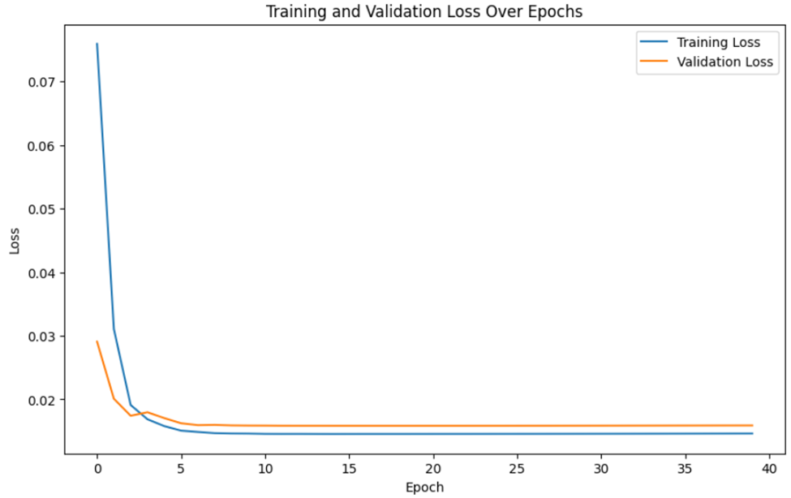
Experiment Setup and Results:
Training and Testing over epochs Plot:
This plot shows the loss (mean squared error) for both training and validation (testing) datasets over the course of 20 training epochs.

Slide 36
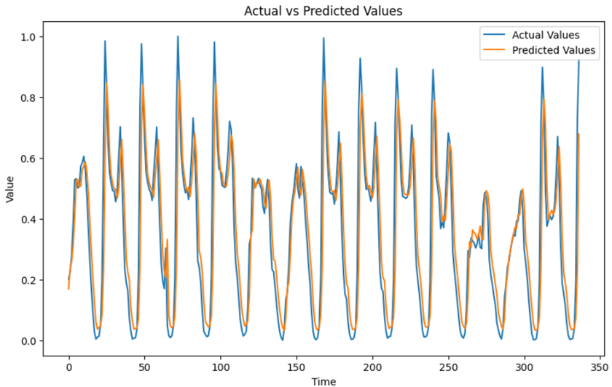
Experiment Setup and Results:
Actual vs. Predicted Values Plot:

Slide 37
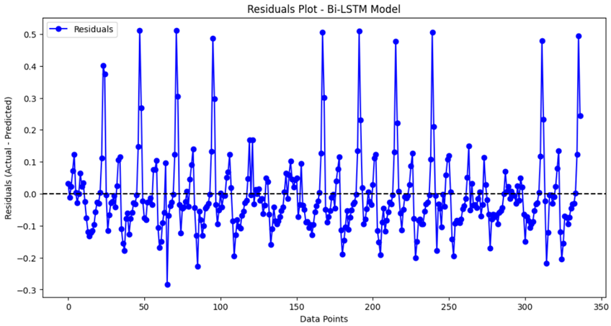
Experiment Setup and Results:
Residuals Plot - Bi-LSTM Model:
The residuals plot visualizes the difference between the actual and predicted values, shown as residuals, for each data point in the test set.

Slide 38
Conclusion
Overall, the project was a success, achieving the primary goals within the set timeframe.
Out of the classification models SVM model was the model with the highest accuracy and performance, on the other hand MLP model was the least model.
Out of the Time-Series Models both LSTM and BI-LSTM performed well based on the prediction and the residuals plots, on the other hand the Echo State model was the least model in predictions and performance.

Slide 39



THANK YOU Any Question?

